Slide 1

Angelbeat

Slide 2

About Me
Shawn Weisfeld
Cloud Solution Architect
Microsoft – One Commercial Partner Technical Team
sweisfel@microsoft.com
Austin, TX

Slide 3
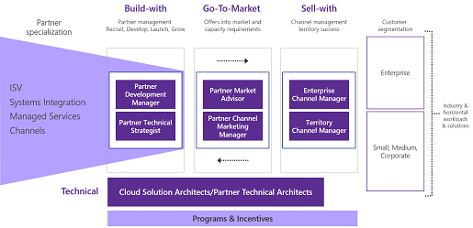
Microsoft – One Commercial Partner

Slide 4


Watch User Group presentations for FREE online! We now have over 700 presentations online
Miss a User Group meeting?
Forget something that you learned?
Want to see content from a User Group not in your area?
Want to share with a buddy?
Presentations from the thought leaders on the topics you care about including:
Agile
Azure
C#
Entity Framework
HTML5
MVC
SQL
jQuery
and Much More!
We know you cannot make it to every session,
that is why we post them online for you!
New Content added all the time!
For new content announcements
@UserGroupTV
http://www.UserGroup.tv

Slide 5
Microsoft’s Cloud Vision
Shawn Weisfeld
Cloud Solution Architect
Microsoft

Slide 6

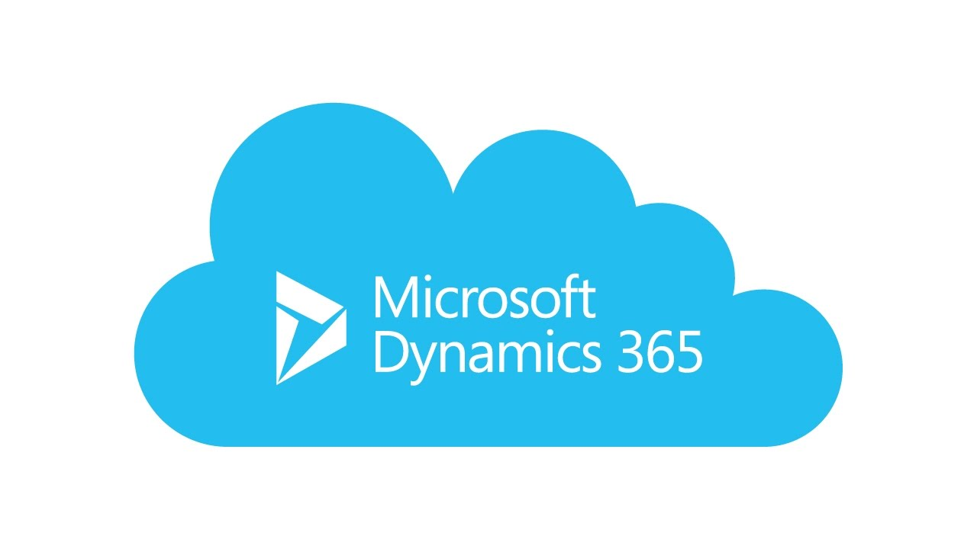
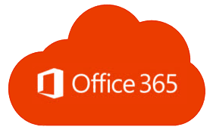

Slide 7
Engage your customers
Transform your products
Digital transformation
Empower your employees
Optimize your operations

Slide 8
Going digital
1 million/hour
new devices coming online by 2020
12 years average age of S&P 500 corporations by 2020
60% computing
in the public cloud by 2025

Slide 9












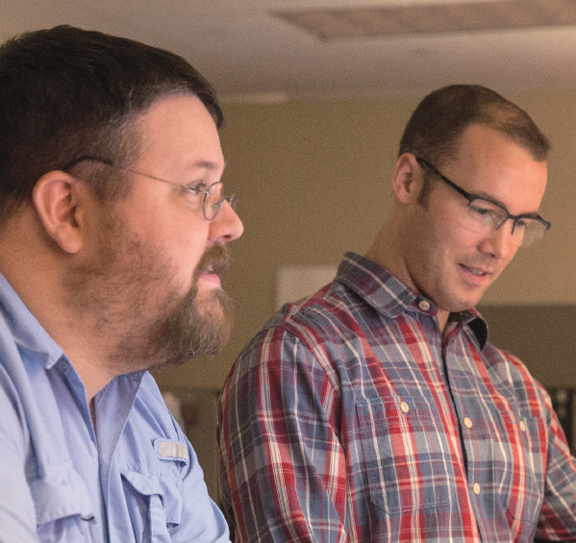
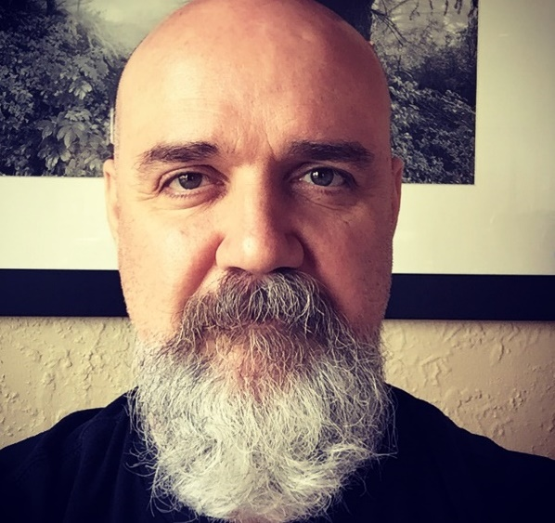

I’m supposed to be an expert on all the new tech as soon as it comes out… I feel like I’m falling behind.
Now that I use the cloud, the expectations to deliver are much higher.
I want to make stuff that won’t get hacked.

Slide 10
Azure. Cloud for all.
Productive
Hybrid
Intelligent
Trusted

Slide 11
Unparalleled developer productivity
Productive
Integrated tooling
Visual Studios Third parties | DevOps
100+ services
Azure Functions Kubernetes | Logic Apps
Unified management
Single cloud | Policy
Hybrid
Intelligent
PLAN
DEPLOY
INTEGRATION
CONTINUOUS DEVELOPMENT
Trusted
CONTINUOUS
BUILD
OPERATE

Slide 12
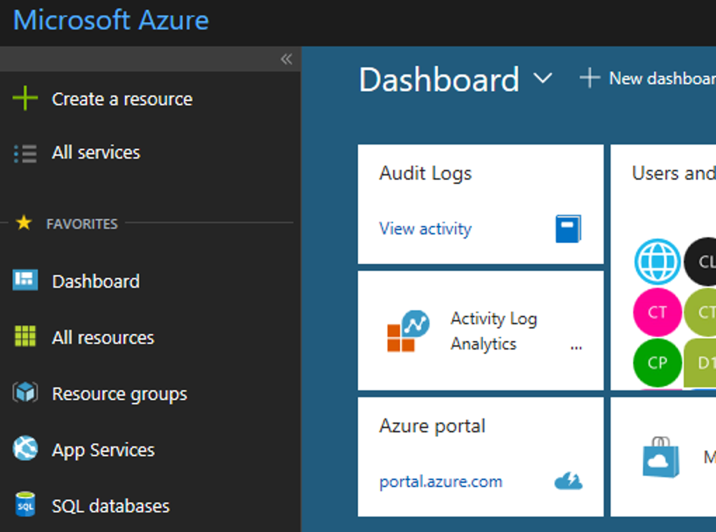
Secure and well-managed for IT
Productive
Govern
Secure
Policy management
Cost management
Security management
Threat protection
Hybrid
Azure portal
Configure
Protect
Intelligent
Update management, scripting
Automation, configuration
Backup and disaster recovery
Trusted
Monitor
App, infrastructure, and network monitoring
Log analytics and diagnostics

Slide 13
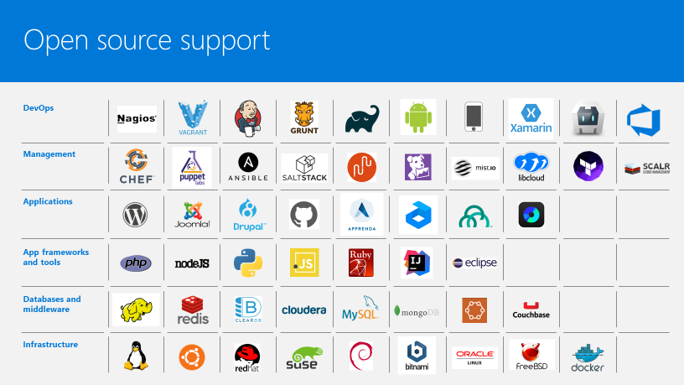


Productive
Hybrid
Intelligent
Trusted

Slide 14
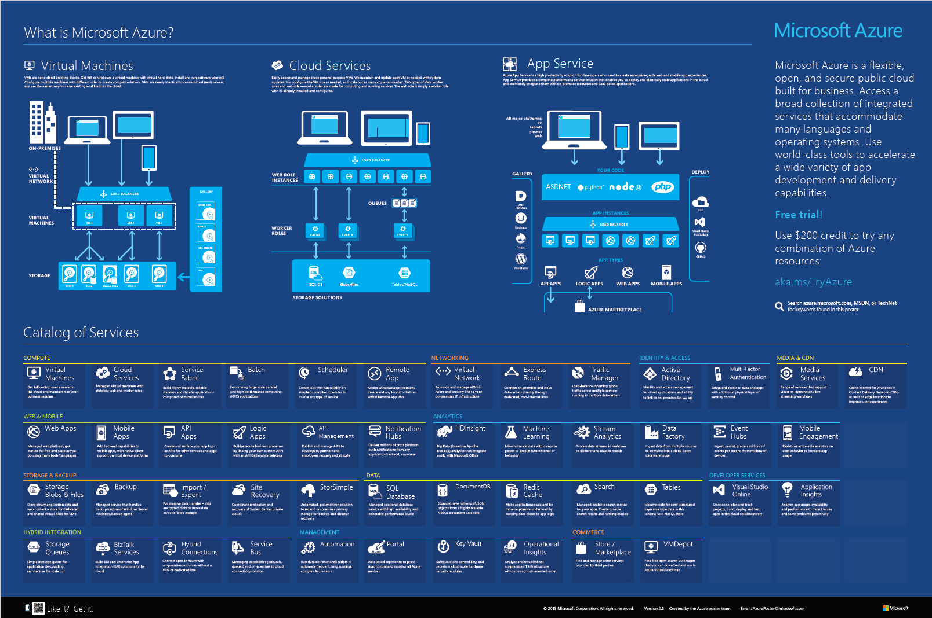
Productive
Hybrid
Intelligent
Trusted

Slide 15
The only consistent, hybrid cloud
Azure Active Directory
Azure services
Azure data services
Azure Security and Management
Productive
Hybrid
Common identity
Unified cloud platform
Data
platform
Security and management
Intelligent
Trusted
Active Directory
Azure
Stack
SQL
Server
On-premises infrastructure

Slide 16
Azure Stack: an extension of Azure
Productive
Hybrid
Intelligent
At the edge and disconnected
Meet every regulatory requirement
Cloud application model on-premises
Trusted

Slide 17





Machine Learning Workbench
Productive
Language APIs
Azure SQL DB
Hybrid
Azure
AI for every developer and every scenario
Intelligent
Azure Machine Learning
Vison API
Trusted
Azure Bot Service

Slide 18
Comprehensive deep learning,
machine learning as a service
Productive
Hybrid
Customizable services
VS, ML STUB, Tensor, Caffe
Tools
Bots, Cognitive, ML
Infrastructure and compute
CPU, GPU, FPGA
Intelligent
Azure
Trusted

Slide 19




































More certifications than any cloud provider
GLOBAL
ISO 27001
ISO 27018
ISO 27017
ISO 22301
SOC 1 Type 2
Productive
SOC 2 Type 2
SOC 3
CSA STAR
Self-Assessment
CSA STAR
Certification
CSA STAR
Attestation
Hybrid
INDUSTRY
PCI DSS
Level 1
CDSA
MPAA
FACT UK
Shared
Assessments
FISC Japan
HIPAA / HITECH Act
Intelligent
HITRUST
GxP
21 CFR Part 11
MARS-E
IG Toolkit UK
FERPA
GLBA
FFIEC
REGIONAL
Argentina PDPA
EU
Model Clauses
UK
G-Cloud
China
DJCP
China
GB 18030
China
TRUCS
Singapore
MTCS
Australia
IRAP/CCSL
New Zealand
GCIO
Trusted
Japan My
Number Act
ENISA
IAF
Japan CS Mark Gold
Spain
ENS
Spain
DPA
India
MeitY
Canada
Privacy Laws
Privacy
Shield
Germany IT
Grundschutz
workbook

Slide 20
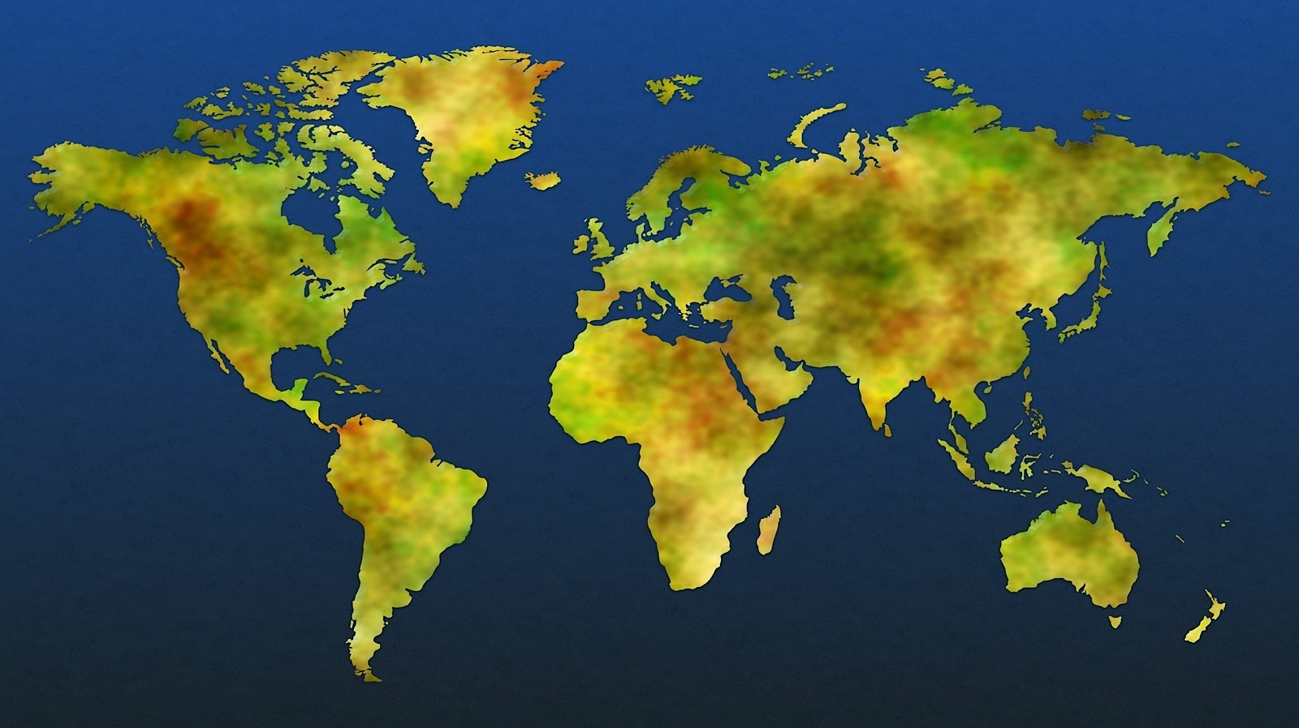



Datacenter security
Two-factor authentication with biometrics
Perimeter fencing
One defined access point
24x7x365 security operations
Verified single-person entry
Video coverage
Secure destruction bins
PERIMETER
BUILDING
2 Mil kilometers intra-datacenter fiber
72+
Tb per second
Backbone
42 Azure regions
100+ datacenters
Millions of servers
Inability to identify location of specific customer data
System check
Background check
Employee and contractor vetting
ACCESS APPROVAL
SERVER ENVIRONMENT

Slide 21
Productive
Hybrid
Intelligent
42
Azure regions
including
3 Sovereign Clouds
Trusted

Slide 22
General Data Protection Regulation (GDPR)
New rules on organizations in the European Union (EU) and those that offer goods and services to people in the EU, or that collect and analyze data tied to EU residents, no matter where they are located, goes into effect May 2018.
Enhanced personal privacy rights
Increased duty for protecting data
Mandatory breach reporting
Significant penalties for non-compliance
Microsoft believes the GDPR is an important step forward for clarifying and enabling individual privacy rights
More Info @ http://www.Microsoft.com/GDPR

Slide 23
Spectre and Meltdown
Jan 3 issues disclosed
Azure was already in the process of patching host infrastructure & PaaS Services
While an OS update is not required to isolate your applications running on Azure from other customers running on Azure, it is always a best practice to keep your OS versions up-to-date.
Azure: https://azure.microsoft.com/en-us/blog/securing-azure-customers-from-cpu-vulnerability/
On Prem: https://support.microsoft.com/en-us/help/4073757/protect-your-windows-devices-against-spectre-meltdown

Slide 24






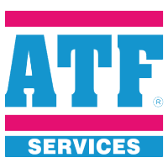






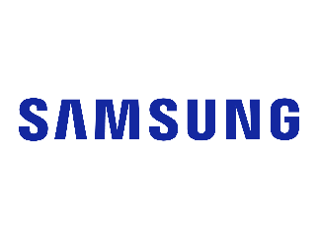







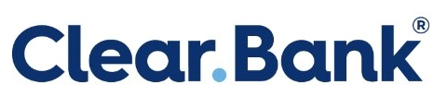
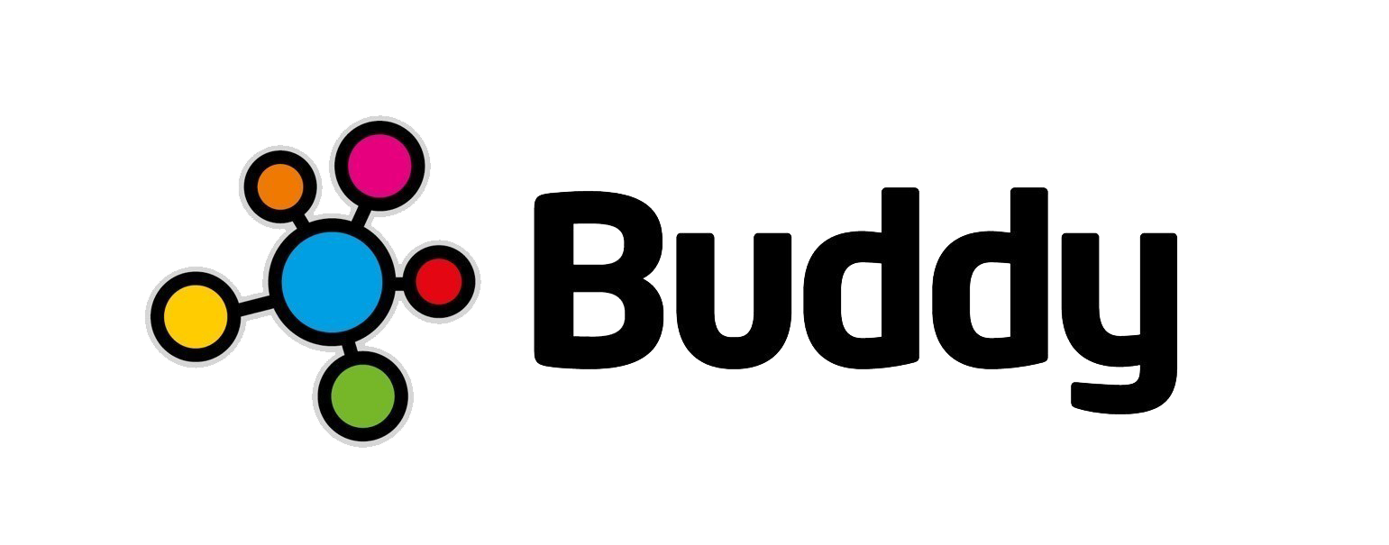







95% of Fortune 500 use Microsoft Cloud

Slide 25
Blockchain: Beyond the Hype
Shawn Weisfeld
Cloud Solution Architect
Microsoft

Slide 26
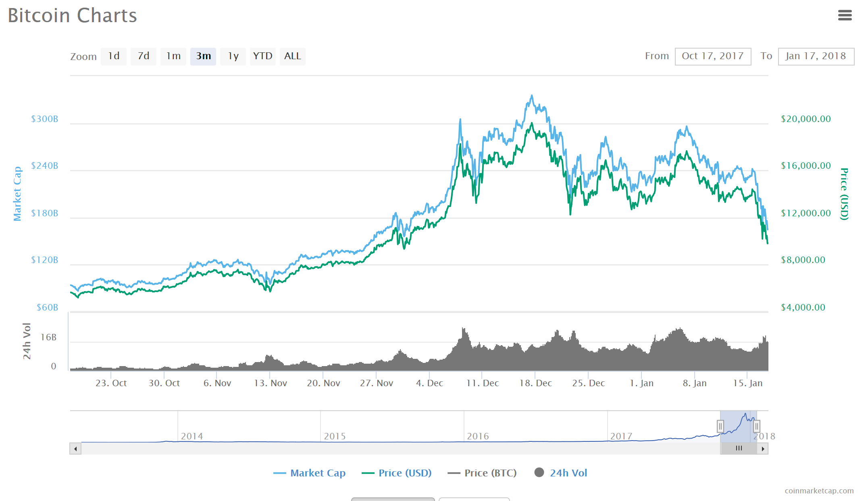
Bitcoin Market Cap
Last 3 months retrieved on 1/17/2018 – Source: https://coinmarketcap.com

Slide 27
Bitcoin
Bitcoin is a cryptocurrency and worldwide payment system. It is the first decentralized digital currency, as the system works without a central bank or single administrator. The network is peer-to-peer and transactions take place between users directly, without an intermediary. These transactions are verified by network nodes through the use of cryptography and recorded in a public distributed ledger called a blockchain. Bitcoin was invented by an unknown person or group of people under the name Satoshi Nakamoto and released as open-source software in 2009.
Source: https://en.wikipedia.org/wiki/Bitcoin

Slide 28
Blockchain
A blockchain is a decentralized and distributed digital ledger that is used to record transactions across many computers so that the record cannot be altered retroactively without the alteration of all subsequent blocks and the collusion of the network
Source: https://en.wikipedia.org/wiki/Blockchain

Slide 29
Blockchain | Advantages
A cryptographically secure, shared, distributed ledger
Secure
Shared
Distributed
Ledger
Each transaction recorded in the database is digitally signed and mathematically guaranteed to be authentic and impervious to fraud.
The database’s main value is that it is shared between separate entities
More entities shared, the greater the value.
Many copies of the database exist and they are replicas of each other in relative time.
A write once, thus immutable, ledger that records every transaction.
The entire history of all transactions is available, math doesn’t lie and there is no where to hide.

Slide 30


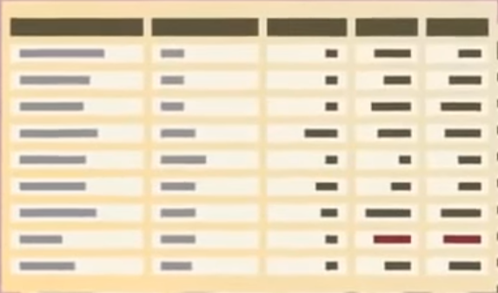



Decentralizes data in a trustless environment
Traditional ledgers are centralized and use third parties and middlemen to approve and record transactions
Blockchain safely distributes ledgers across the entire network and does not require any middleman
The technology maintains multiple replicas like P2P torrent file sharing
Traditional System
Blockchain System
Centralized system with stored ledger
Distributed system with distributed ledger

Slide 31
Ledger: Blockchain uses a distributed ledger to track transactions
A ledger is a write only database most commonly used in accounting
The digital distributed ledger creates the same copy of the data across all the participating nodes
All new transactions are digitally signed and then broadcast across the blockchain network to be added to the system
Participants in the blockchain verify the transaction is valid and then writes it to the ledger
FROM | TO | PROPERTY | VALUE
Alex | Katie | Payment | $500
Jim | Sally | Payment | $300
Alex | Garth | Asset | Car
Katie | Tony | Payment | $100
Molly | Paula | Message | I love you
Example ledger
Entire network has same ledger

Slide 32
Blockchain | Network Types
Public
Private
Consortium
Public blockchain
Persona
Woodgrove Financial
Person B
Northwind Traders
Bank 6
Bank 1
Consortium 6
Bank A Blockchain
Location 1
Location 2
Location 3
Location 4
Department A
Department B
Consortium
Woodgrove Financial
Contoso Bank
Northwind Traders
Bank b
Insurance c
Investment consortium c
Many, unknown participants
Writes by all participants
Reads by all participants
Consensus by Proof of Work
Known participants from one organization
Write permissions centralized
Reads may be public or restricted
Multiple algorithms for consensus
Known participants from multiple organizations
Writes require consensus of several participants
Reads may be public or restricted
Multiple algorithms for consensus
Source: Ethereum blog by Vitalik Buterin https://blog.ethereum.org/author/vitalik-buterin/

Slide 33




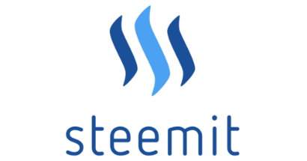


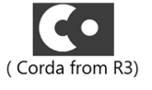

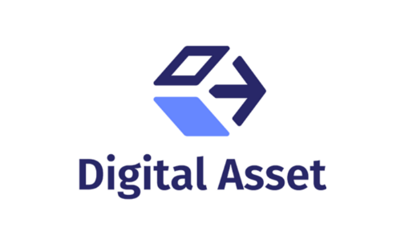


Blockchain | Multiple Chain Types
Blockchains
General Propose Chain
(cryptocurrency)
(cross-industry collaborative)
Alternative blockchains (altchains)
General Propose Chain
(cross-industry collaborative)
(Social News
Blockchain DB)
(Decentralized
Transport)
(IBM Open Blockchain )
(FSI consortium)
open platform for
developers and devops
to build blockchain apps
(banking industry collaborative)

Slide 34
Database vs. Blockchain
Database
Overseen by central authority (owner)
Single point of failure which is vulnerable to attack
Easily altered, agile, high throughput and low latency
Blockchain
Overseen by predefined consensus algorithm (no owner)
Distributed fabric, highly resilient. Vulnerable to 51% attack
Somewhat difficult to alter, generally slower throughput

Slide 35
Potential Benefits of Blockchain
Eliminates Intermediaries increasing efficiency and speed
Reduces Fraud related to data integrity
Operation simplification by helping to reduce cost and time related reconciliations and disputes
Helps Increase Revenue from new business model and saving

Slide 36
How does it work?

Slide 37
Evolution of Blockchain
Blockchain 1.0 – A simple ledger
Blockchain 1.0
Simple Ledgers that record transactions

Slide 38

EXAMPLE
Basic blockchain to track financial transactions
In this example, Alex wants to send Katie $500 via a financial transaction blockchain system
Tx
FROM | TO | PROPERTY | VALUE
Alex | Katie | Payment | $500
Tx
Signature
Signature
Tx
Signature
Tx
Signature
Transaction (Tx)
From: Alex (0xf5e…)
To: Katie (0x992…)
Amount: 500
Tx
2. Transaction is confirmed through mining.
Tx
Signature
Tx
Digital signature 0x23e423s3234…
Signature
Signature
1. Transaction information goes through hash functions (to secure it as well as create a time stamp)
3. Confirmed transaction gets pushed to network

Slide 39
Blockchains create a transaction chain that maintains the history of ownership of an asset
The ledger itself does not keep track of digital asset account balances, it simply records transactions.
Instead of balances, ownership of digital assets is verified by links to previous transactions, using the immutable history inherently available in a blockchain solution.
For example. For Alex to send $500 to Katie, he must reference previous transactions where he has received $500 or more to demonstrate that he, indeed, has that much money to send. These reference transactions are called previous input transactions. The current transaction(s) is called output transaction(s).
Validity of each transaction is based on the validity of previous transactions, which is shared.
Previous transactions
Transaction
From: Garth (0xas2…)
To: Alex (0xf5e…)
Amount: 200
Inputs: 0xtd6…, 0xj7d…
Current transaction
Transaction
From: Alex (0xf5e…)
To: Katie (0x992…)
Amount: 500
Inputs: 0x56e…, 0x987…
Transaction
From: Sally (0xkj5…)
To: Alex (0xf5e…)
Amount: 300
Inputs: 0xkf7…, 0x9dh…
Digital signature 0x56e…
Digital signature 0x23e423s3234…
FROM | TO | PROPERTY | VALUE
Alex | Katie | Payment | $500
Digital signature 0x987…

Slide 40
Evolution of Blockchain
Blockchain 2.0 – Introducing Smart Contracts
Blockchain 2.0
+ Smart Contracts
Logic Tier
Blockchain 1.0
Simple Ledgers that record transactions

Slide 41
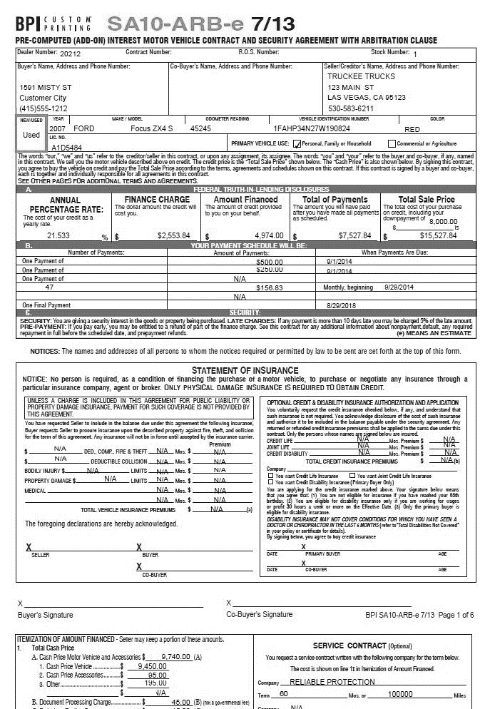

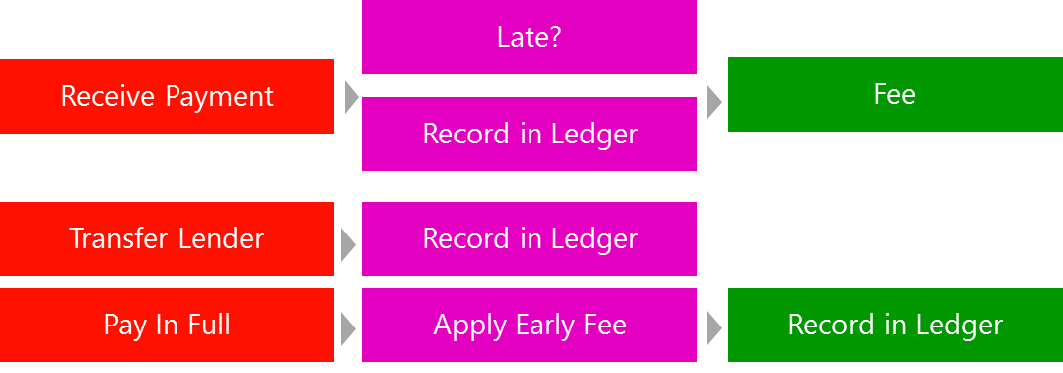
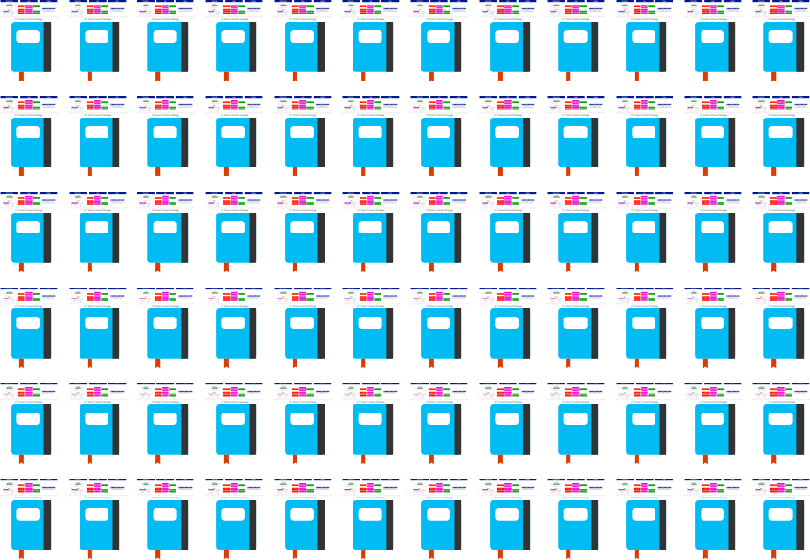
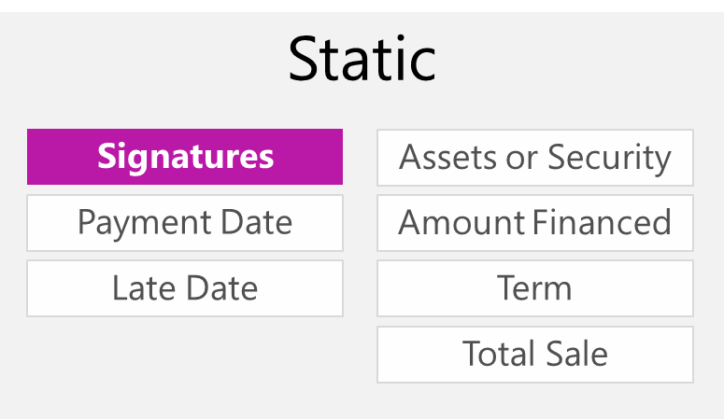
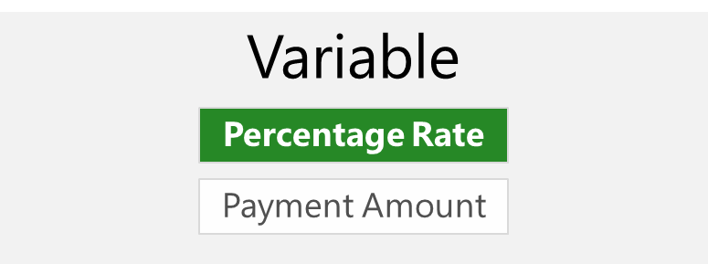
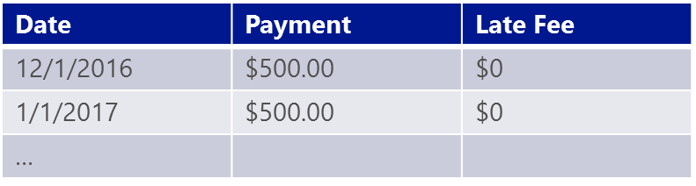
Blockchain 2.0 | Smart Contracts
Traditional Contract
Smart Contract Package
Deployed to Nodes
Logic
Properties
Ledger

Slide 42

Evolution of Blockchain
Blockchain 3.0 – Microsoft evolving the ledger to address the big problem
Blockchain 3.0
+ Cloud Servicing
Multilayer Middleware
+ Cryptlets
Blockchain 2.0
+ Smart Contracts
Logic Tier
Blockchain 1.0
Simple Ledgers that record transactions

Slide 43
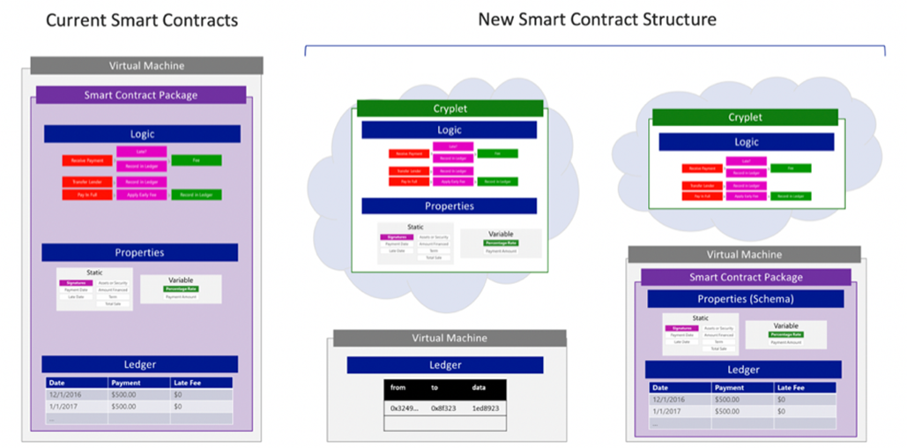
Blockchain 3.0 | State-of-the-art cryptlets innovation

Slide 44
Blockchain shows tremendous potential across industries
Manufacturing
Retail
Insurance
Banking and Capital Markets
Government
Health
Asset tracking
Real time auction for supplier contracts
Supply chain transparency
Loyalty tracking
Product provenance
Logistics management
Claims Management
MBS/Property Payments
Fraud detection
Automated underwriting
Bond Issuance
Trade Finance
Loan Syndication
Post Trade Settlement
Cross Border Payments
Derivatives Trading
KYC/AML
Licensing and ID
Benefits distribution
Aid tracking
Military security
Personalized medicine
Records sharing
Compliance

Slide 45
Popular scenarios where Blockchain adds value
Financial
Trading
Deal origination
POs for new securities
Equities
Fixed income
Derivatives trading
Total Return Swaps (TRS)
2nd generation derivatives
The race to a zero middle office
Collateral management
Settlements
Payments
Transferring of value
Know your client (KYC) Anti money laundering
Crowd Funding
Peer-to-peer lending
Compliance reporting
Trade reporting & risk visualizations
Betting & prediction markets
Insurance
Claim filings
MBS/Property payments
Claims processing & admin
Fraud detection/prediction
Telematics & ratings
Digital authentication
Asset management
Automated underwriting
Self-administered insurance
Media
Digital rights mgmt
Game monetization
Art authentication
Purchase & usage monitoring
Ticket purchases
Fan tracking
Ad click fraud reduction
Resell of authentic assets
Real time auction & ad placements
Computer Science
Micronization of work (pay for
algorithms, tweets, ad clicks, etc.)
Expanse of marketplace
Disbursement of work
Direct to developer payments
API platform plays
Notarization & certification
P2P storage & compute sharing
DNS
Medical
Records sharing
Prescription sharing
Compliance
Personalized medicine
DNA sequencing
Asset Titles
Diamonds
Designer brands
Car leasing & sales
Home Mortgages & payments
Land title ownership
Digital asset records
Government
Voting
Vehicle registration
WIC, Vet, SS, benefits, distribution
Licensing & identification
Copyrights
Identity
Personal
Objects
Families of objects
Digital assets
Multifactor Auth
Refugee tracking
Education & badging Purchase & review tracking
Employer & Employee reviews
IoT
Device to Device payments
Device directories
Operations (e.g. water flow)
Grid monitoring
Smart home & office management
Cross-company maintenance markets
Payments
Micropayments (apps, 402)
B2B international remittance
Tax filing & collection
Rethinking wallets & banks
Consumer
Digital rewards
Uber, AirBNB, Apple Pay
P2P selling, craigslist
Cross company, brand, loyalty tracking
Supply Chain
Dynamic ag commodities pricing
Real time auction for supply delivery
Pharmaceutical tracking & purity
Agricultural food authentication
Shipping & logistics management

Slide 46




Market Challenges
HYPE
Lots of hype and noise.
IMMATURE Many offerings are immature and early.
NOT ENTERPRISE READY
Most technology providers don’t have enterprise DNA.
PATH TO PRODUCTION IS AMBIGUOUS Not always clear to go from concept to production.

Slide 47
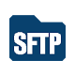


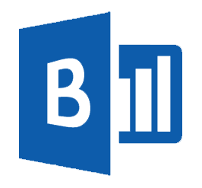
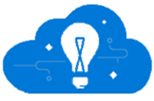
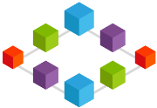



What do Blockchain Architectures look like?
Event Producers
Collection
Ingestor
(broker)
Transformation
Long-term storage
Presentation Layer
Stream Analytics
Modern Applications
Microsoft
Power BI based
Dashboards
Stream processing
HD
Insight
Storm
Event Hubs
Service bus
Azure DBs
Azure storage
HDInsight
SQL Data Warehouse
Azure Data Lake
Search and query
Modern
Applications
Cloud
Gateways
Business
Logic Apps
Microsoft Cortana Analytics
Notifications and workflow interactions on devices
Identity and Key Management
Functions
Blockchain
Communication with existing LoB via Industry Protocols or Enterprise Infrastructure
IaaS Hosted Code
Smart Contracts
Blockchain Ledger
Azure
Active Directory
Azure
Key Vault

Slide 48
Build development environment consisting of blockchain protocol clients and network infrastructure
Build Blockchain Network on premises/cloud providers: 3 weeks
Review blockchain protocol specific network documentation
Determine topology for a consortium network
Map topology to IT resources
Manually deploy
Configure blockchain clients via Linux BASH scripts to support private network (peering, isolate mining nodes, etc.)
Configure other blockchain protocol properties (consensus algorithms, max peers, etc.)
Trial and error to make above steps work
Configure IT networks and firewall ports to permit blockchain protocol traffic
Test, debug, and repeat
Deploy Blockchain Network in Azure using BaaS Bletchley Framework: 15 minutes
Activate Azure subscription
Search Azure Marketplace for desired blockchain
Click on blockchain image of choice
Provide 10 user parameters (number of consortium members, number of blockchain VMs, admin usernames and passwords, etc.)
Deploy and wait 15 minutes (+/- depending of nodes selected)
VS

Slide 49




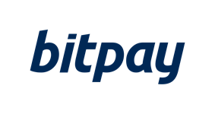


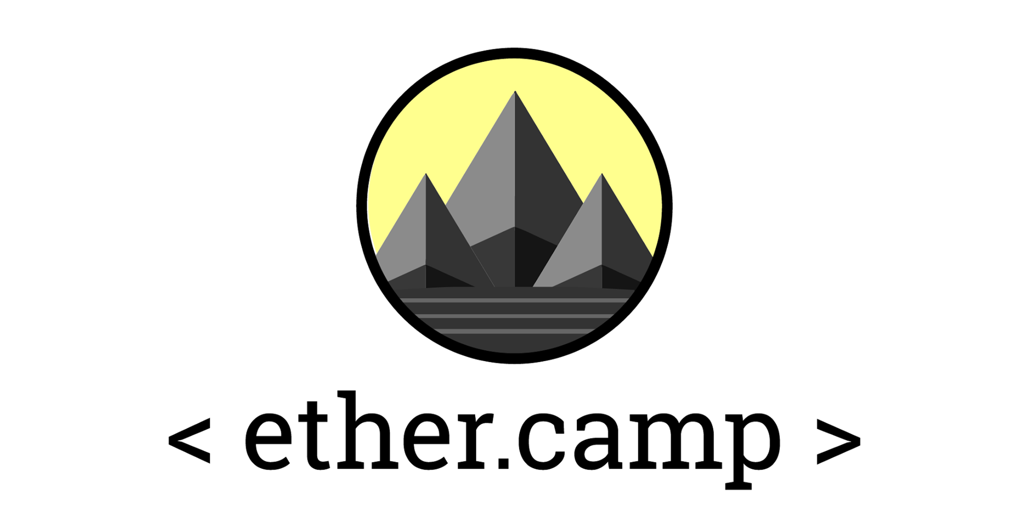










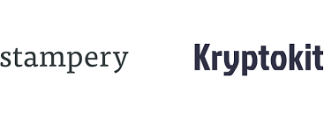

Why Microsoft for Blockchain?
Open Blockchain Ecosystem
Our platform will integrate with your investments
Regulatory and Compliance Ready (including Financial Services)
Azure

Slide 50
Tenets of our BaaS Strategy
FAIL FAST & CHEAP
in a development test environment
MIX & MATCH from the world-class blockchain technologies
CREATE & INNOVATE
by building solutions on blockchain quickly
SHARE SOLUTIONS through a worldwide distributed platform
PROVISION with one-click to test & iterate

Slide 51
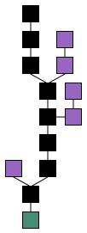
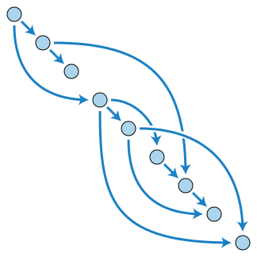
What is next?
IOTA - directed acyclic graph (DAG)

Slide 52
Data & AI: Trends and Tools
Shawn Weisfeld
Cloud Solution Architect
Microsoft

Slide 53
Data
Structured
Unstructured/Loosely Structured
Inflight
Cache

Slide 54
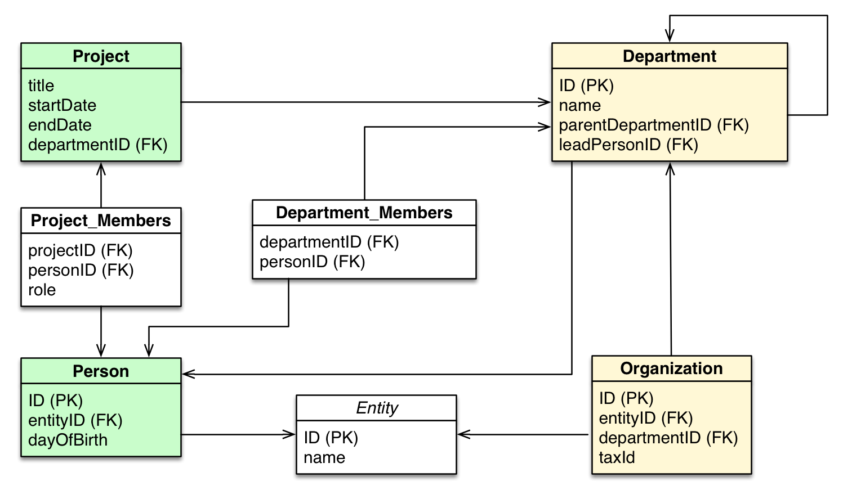
Structured
Traditional Relational Databases on VMs
SQL Server, Oracle, MySQL, PostgreSQL, etc.
Relational Database Services
SQL Database, Azure Database for MySQL, Azure Database for PostgreSQL, SQL Data Warehouse
Source: https://neo4j.com/developer/graph-db-vs-rdbms

Slide 55
Unstructured/Loosely Structured
Files in Storage
In a VM (Disk)
Blob (Hot, Cool, Archival)
Data Lake Store
Limitless secure HDFS store, optimized for analytics workloads
NoSQL/Document
On a VM
CosmosDB
APIs – SQL (DocumentDB), MongoDB, Graph, Table, Cassandra
Globally distributed, 5 consistency models

Slide 56
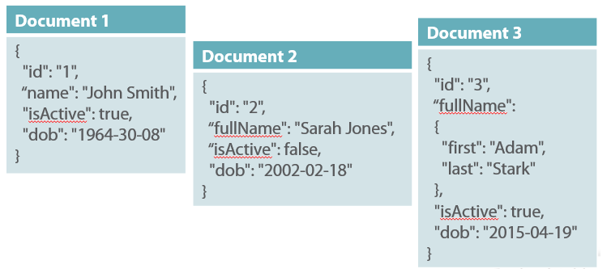
NoSQL/Document
Documents are hierarchical sets of key value pairs
JSON
Support for querying, functions, triggers, stored procedures varies based on platform.

Slide 57
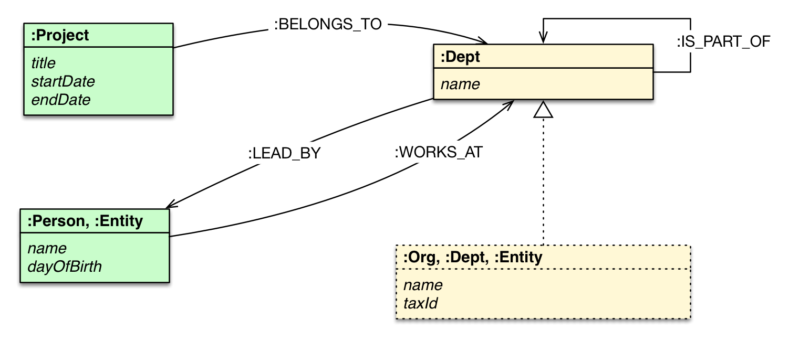
NoSQL/Graph
Ideal for situations where the relationship is
Vertices (Nodes, Tables, nouns)
Edges (Relationships) directed
Each with properties (key value pairs)
The relationship is king
Source: https://neo4j.com/developer/graph-db-vs-rdbms

Slide 58
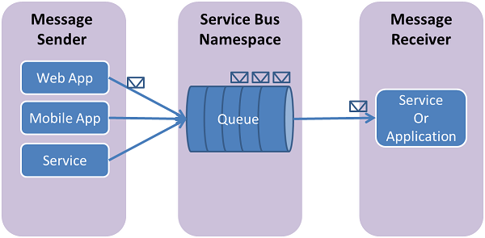
Inflight
On a VM
MSMQ, RabbitMQ, etc.
As a Service
Storage Queues
Service Bus Queues
Event Hubs
IoT Hubs
Event Grid
HDInsight - Kafka

Slide 59
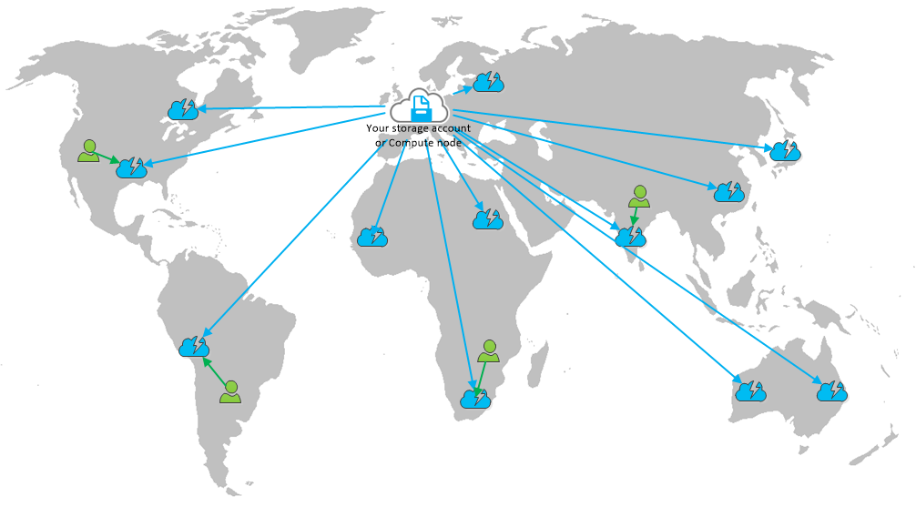
Cache
Optimized for short term storage
Behind the app
On a VM
Redis Cache Service
In front of the app
CDN (Verizon or Akamai)

Slide 60
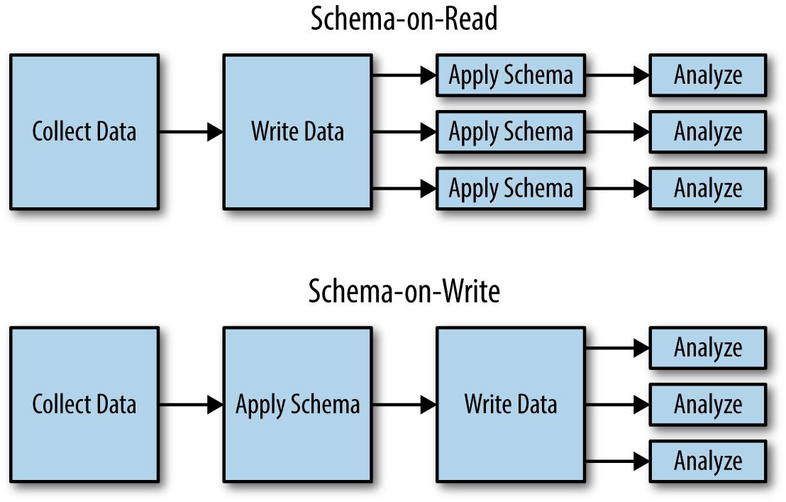
Data Analysis
HDInsight
Hadoop, Spark, Hbase, Interactive Query, Kafka, Storm, R Server, etc.
Data Bricks
Apache Spark-based analytics platform
SQL Data Warehouse
SQL Analysis Services
Data Lake Analytics
Stream Analytics
On a VM
SQL Server with R

Slide 61
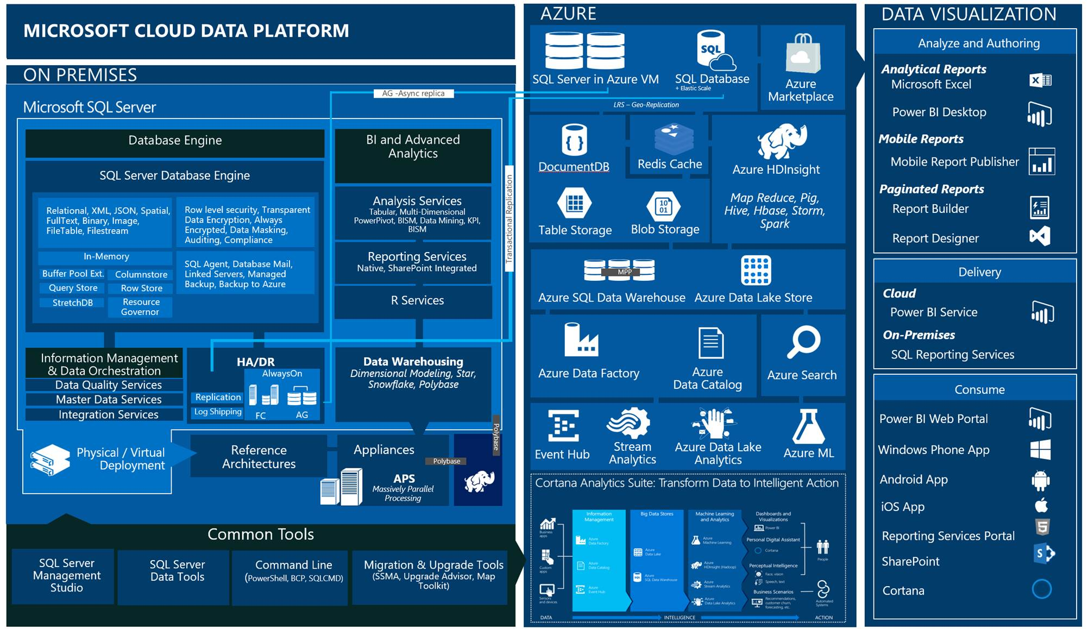

Slide 62







Microsoft Cognitive Services
Give your apps a human side
Vision
Speech
Language
Knowledge
Search
Labs
Computer Vision
Content Moderator
Emotion
Face
Video Indexer
Bing Speech
Speaker Recognition
Bing Spell Check
Linguistic Analysis
Text Analytics
Translator Text & Speech
Web Language Model
Academic Knowledge
Entity Linking
Knowledge Exploration
Recommendations
QnA Maker
Bing Autosuggest
Bing Image Search
Bing News Search
Bing Video Search
Bing Web Search
Bing Entity Search
Project Prague (gesture)
Project Cuzco (events)
Project Johannesburg (routing)
Project Nanjing (isochrones)
Project Abu Dhabi (distance matrix)
Project Wollongong (location)
CUSTOMIZATION
Custom Vision Service
Custom Speech Service
Language Understanding
Custom Decision Service
Bing Custom Search

Slide 63






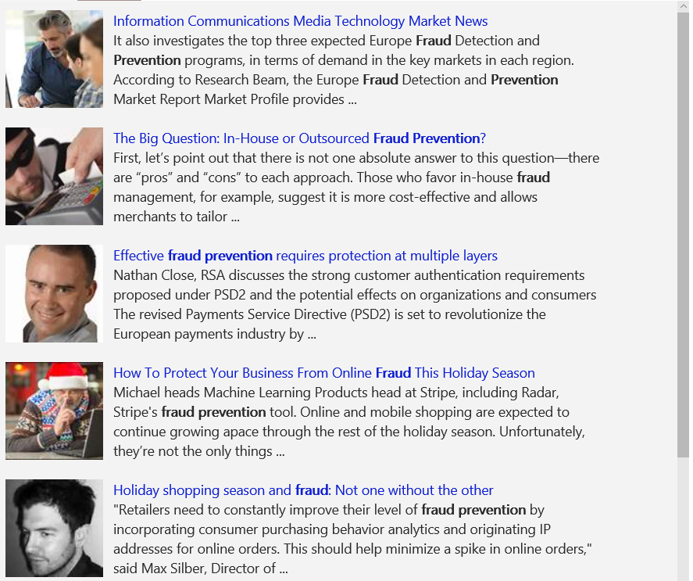
A variety of real-world applications
Vision
Speech
Language
Knowledge
Search
What is in the image?
Give me directions to the nearest local branch.
Play today’s customer call recording.
Top publications in customer lifecycle trends?
Search for ‘fraud prevention’
Computer Vision
Bing Speech
Language Understanding
Knowledge Exploration
Bing News Search
Natural Language Processing
Here are the top results:
Here is what I found:
Intent: PlayCall
Content: Customer#
DateTime.date: today
Customer Relationship Management – 5 Key Trends for 2014 CRM
Oct 28, 2015 – Here are FIVE key trends in 2014 that would help marketers in rolling ... Of late, marketers are looking at customer lifecycle management (CLM)
Information Communications Media Market News
It also investigates the top three expected Fraud Detection and Prevention programs, in terms of demand in key markets…
Predictive Customer Lifecycle Management (CLM)
The purpose of Customer Life-cycle Management (CLM) is to maximize both customer retention and .... Predictive trend analysis provides business visibility.
The Big Question: In-House or Outsourced Fraud Protection?
First, let’s point out that there is not one absolute answer—there are “pros” and “cons” to each. Those who favor in-house…
Category | People; 5 faces
Adult/Racy? | False/False
Dominant colors
Accent color
Convert spoken audio to text
Trends 2016: The Future of Customer Service
Jan 5, 2016 – The top 10 customer service trends for 2016 that .... North American Consumer
How to Protect Your Business from Online Fraud this Holiday Season
Michael heads fraud prevention tool. Online and mobile shopping are expected to continue growing apace…
Convert text to spoken audio
Now Playing
Extract intent of user
11/29/2016 Customer Call
Language Around Customer Lifecycles in the Banking Industry
View PDF

Slide 64
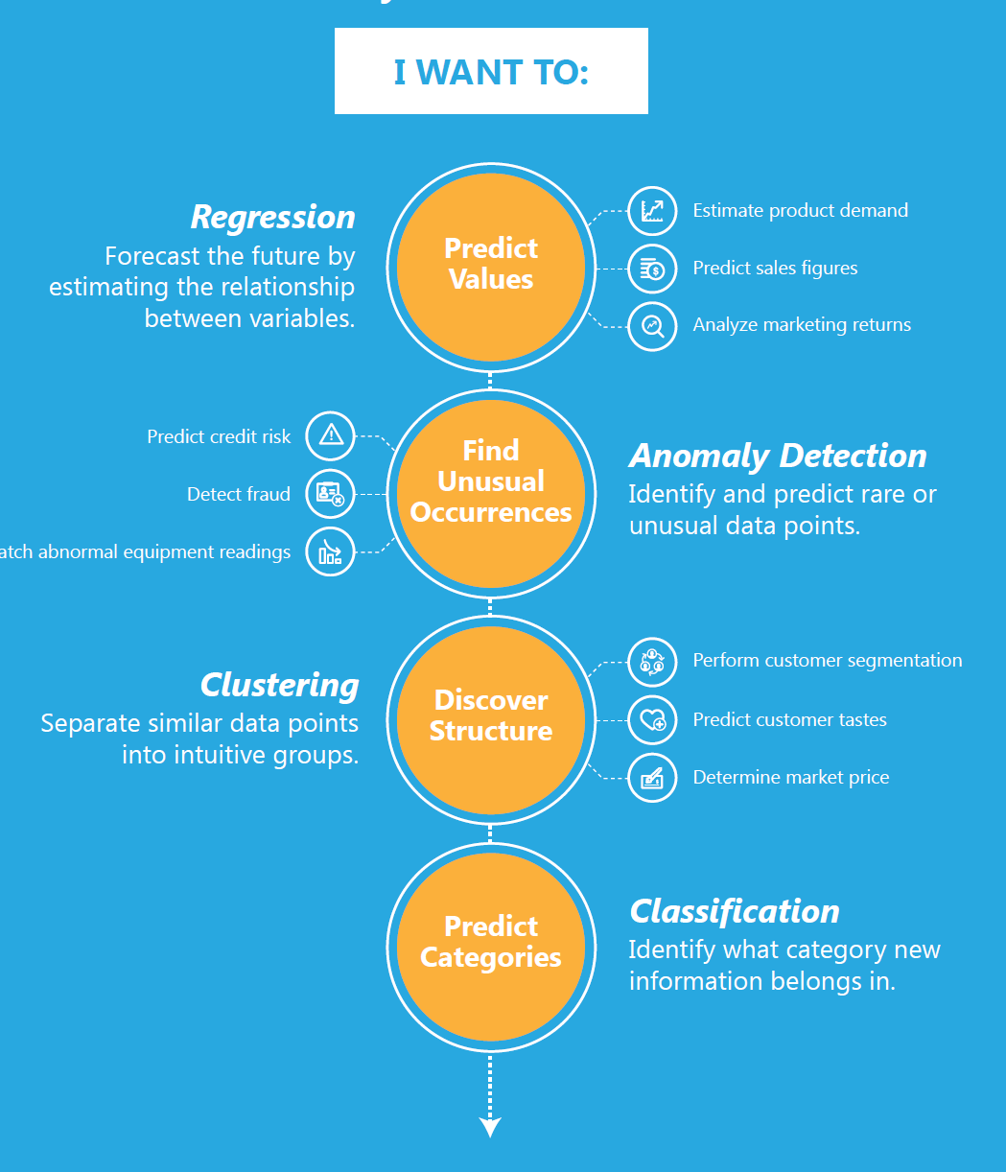
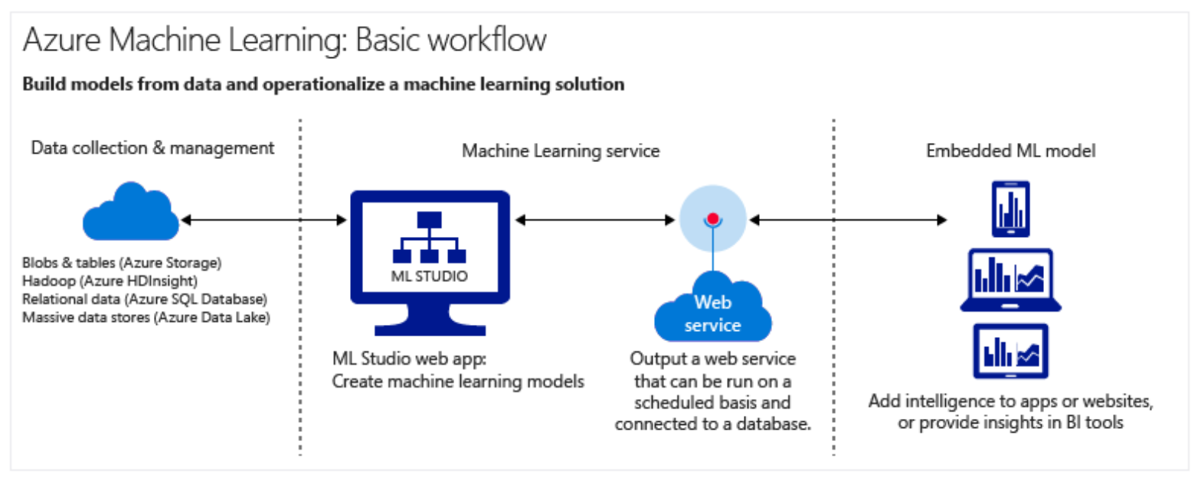
Machine Learning
Use existing data to forecast future behaviors, outcomes, and trends

Slide 65
Other
Azure Batch AI
VMs
CPU and GPU based
Tools
The Microsoft Cognitive Toolkit (CNTK)
Google Tensorflow

Slide 66
VM’s, Containers, Serverless: Making the right choices
Shawn Weisfeld
Cloud Solution Architect
Microsoft

Slide 67
In the beginning…

Slide 68
Containers on Windows and Linux
Windows
Process
Windows Server Container
Hyper-V Container
Virtual Machine
Shared Kernel
Linux
Process
Linux Container
Virtual Machine
Shared Kernel
Less Overhead Better Isolation & Security

Slide 69
Unique benefits enabled by containers
Immutable environment
Container image has all application dependencies
High portability limiting “works on my machine”
Resource governance
Declarative resource limits for memory, cpu, io, etc.
Service Fabric offers this for *all* services (containerized or not)
Isolation
Containers spoof isolated OS instance
Limit impact of other applications in other containers

Slide 70
Benefits enabled by microservices & containers
Increase agility through componentization
Simplify upgrades through independent versioning
Increase productivity through heterogeneous tech
Improve HW utilization with granular resource balancing
Improve HW utilization via improved density
Limit the impact of failures through isolation

Slide 71
Containers and microservices have needs….
to discover and talk to each other
to manage state
to be upgraded with zero downtime
to report health & resource usage
to be placed appropriately
to be scaled in/out on demand
to be resilient to HW and SW faults

Slide 72
Azure Container Service (ACS)
Quickly deploy a production ready Kubernetes, DC/OS, or Docker Swarm cluster

Slide 73
Azure Container Service (AKS) – Managed K8S
Easy to use
Fastest path to Kubernetes on Azure
Up and running with 3 simple commands
Easy to manage
Automated upgrades and patching
Easily scale the cluster up and down
Self-healing control plane
Uses Open APIs
100% upstream Kubernetes
You only pay for the VMs running your containers!

Slide 74
Azure Container Instances (ACI)
You deploy your docker containers.
Windows or Linux
Pay for the CPU and Memory you request, billed by the second.

Slide 75

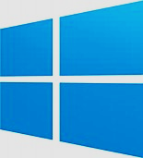

Service Fabric
Web Apps
ASP.NET Core
- OWIN
Reliable Actors
Guest Executables
(Any Code)
Reliable Services
Containers
Lifecycle
Management
Always On Availability
Programming Models
Health & Monitoring
Dev & Ops Tooling
Auto
scaling
Orchestration
Dev Box
Azure
On Premises
On Other Clouds

Slide 76
Azure App Service
Web App/Svc Hosting
Built in tooling for web scenarios
Load Balancing, Auto Scaling
Purchase by the VM
Windows and Linux
Supports .NET, Java, Node, PHP, Python, HTML & more

Slide 77


Azure Functions
Serverless, pay only when your code is running
Triggered by actions
Http request, file in storage, message in queue, etc.
Code
Azure Functions
Events + data

Slide 78
Call to Action
Play with these services in Azure
Let us know what you think – http://feedback.azure.com
Evaluate workloads that you have that this would help with

Slide 79
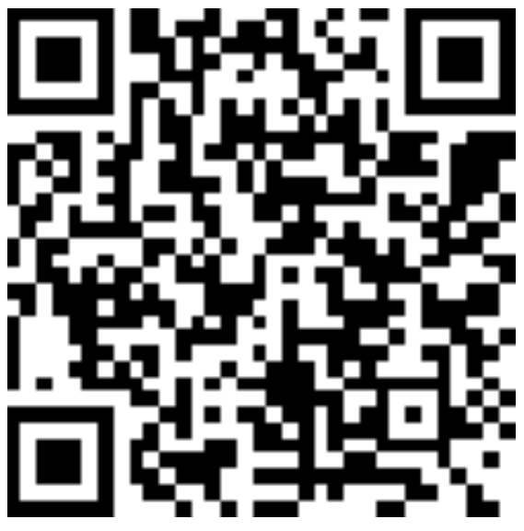
Thank you! Your Feedback is Important
Rate My Talk & Download Slides!
http://bit.ly/RateShawnsTalk
(case sensitive)
Contact Information
Email: sweisfel@microsoft.com
Blog: http://www.shawnweisfeld.com
Twitter: @shawnweisfeld

